Slide 1

인공지능
[ Artificial Intelligence ]
무단 전재/재배포 금지

Slide 2
Clustering
09
What is Clustering?
Clustering techniques
Evaluation of clustering
Use Case: Mall Customer Clustering

Slide 3
What is Clustering?

Slide 4
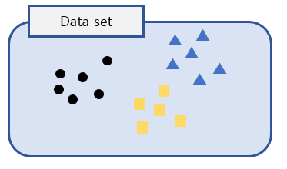
Clustering Concept
What is Clustering?
The process of partitioning a set of data objects into subsets
A subset is called cluster
Clustering data objects that are similar to each other

Slide 5
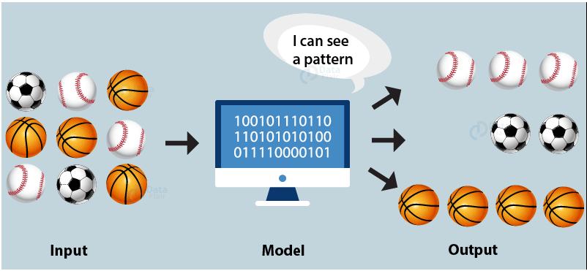
Clustering Concept
Clustering example

Slide 6
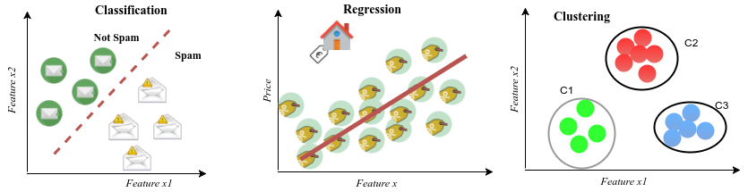
Clustering Concept
Difference
Classification: KNN, Decision Tree
Regression: Linear and Logistic regression
Clustering: K-Means, Agglomerative Filtering, DBSCAN

Slide 7
Clustering Concept
Applications
Segmenting customers into groups with similar demographics or buying patterns for targeted marketing campaigns
Detecting anomalous behavior
Unauthorized network intrusions, by identifying patterns of use falling outside the known clusters
Simplifying extremely large datasets
Group features with similar values into a smaller number of homogeneous categories

Slide 8
Clustering Techniques
B

Slide 9
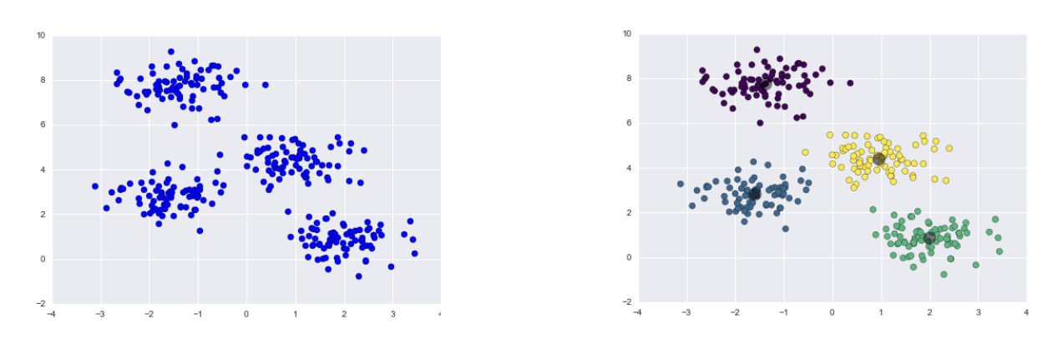
Clustering Techniques
K-Means
K is number of clusters
A centroid-based technique
Centroid is the average of objects belonging to each cluster
Groups each object with the closest centroid

Slide 10
Clustering Techniques
K-Means Procedure
Step 1: Determine parameter k (k > 0)
Step 2: Randomly choose k points for starting centroids.
Step 3: Form k clusters by assigning all points to the closest centroid
Step 4: Recompute the centroid of each cluster (Calculate the mean of each cluster)
Step 5: repeat Step 3 until the centroid don’t change

Slide 11
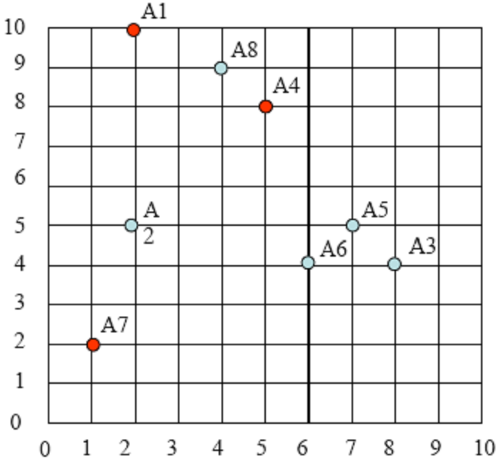
Understanding clustering
k-means example
Step 1: Determine parameter k (k > 0)
Step 2: Randomly choose k points for starting centroids.
 | Point
A1 | (2, 10)
A2 | (2, 5)
A3 | (8, 4)
A4 | (5, 8)
A5 | (7, 5)
A6 | (6, 4)
A7 | (1, 2)
A8 | (4, 9)
C1
C2
C3

Slide 12
Understanding clustering
k-means example
Step 3: Form k clusters by assigning all points to the closest centroid
 | Point | C1(2, 10) | C2(5, 8) | C3(1, 2) | Cluster
A1 | (2, 10) | 0 | 3.60 | 8.06 | C1
A2 | (2, 5) | 5 | 4.24 | 3.16 | C3
A3 | (8, 4) | 8.48 | 5 | 7.28 | C2
A4 | (5, 8) | 3.60 | 0 | 7.21 | C2
A5 | (7, 5) | 7.07 | 3.60 | 6.70 | C2
A6 | (6, 4) | 7.21 | 4.12 | 5.38 | C2
A7 | (1, 2) | 8.06 | 7.21 | 0 | C3
A8 | (4, 9) | 2.23 | 1.41 | 7.61 | C2

Slide 13
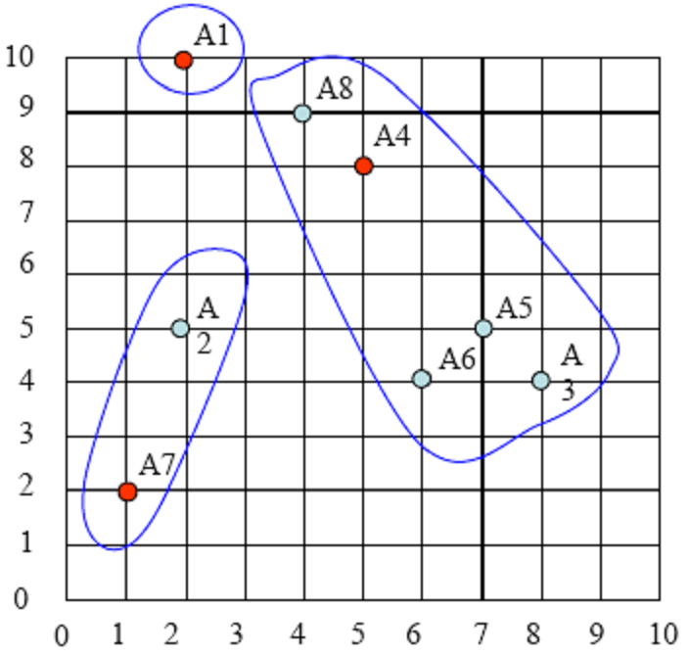
Understanding clustering
k-means example
Step 3: Form k clusters by assigning all points to the closest centroid
C1
C2
C3

Slide 14
Understanding clustering
k-means example
Step 4: Recompute the centroid of each cluster (Calculate the mean of each cluster)
 | Point | Cluster | Mean of C#
A1 | (2, 10) | C1 | (2, 10)
A3 | (8, 4) | C2 | (6, 6)
A4 | (5, 8) | C2
A5 | (7, 5) | C2
A6 | (6, 4) | C2
A8 | (4, 9) | C2
A7 | (1, 2) | C3 | (1.5, 3.5)
A2 | (2, 5) | C3

Slide 15
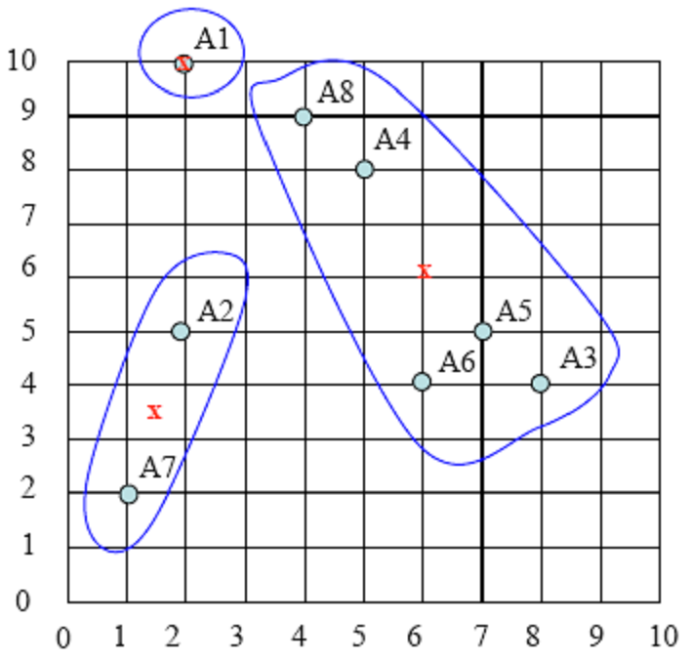
Understanding clustering
k-means example
Step 4: Recompute the centroid of each cluster (Calculate the mean of each cluster)
C1
New centroids
C2
C3

Slide 16
Understanding clustering
k-means example
Step 5: repeat Step 3 until the centroid don’t change
Step 3: Form k clusters by assigning all points to the closest centroid
 | Point | C1(2, 10) | C2(6, 6) | C3(1.5, 3.5) | Cluster
A1 | (2, 10) | 0 | 5.65 | 6.51 | C1
A2 | (2, 5) | 5 | 4.12 | 1.58 | C3
A3 | (8, 4) | 8.48 | 2.82 | 6.51 | C2
A4 | (5, 8) | 3.60 | 2.23 | 5.70 | C2
A5 | (7, 5) | 7.07 | 1.41 | 5.70 | C2
A6 | (6, 4) | 7.21 | 2 | 4.52 | C2
A7 | (1, 2) | 8.06 | 6.40 | 1.58 | C3
A8 | (4, 9) | 2.23 | 3.60 | 6.04 | C1

Slide 17
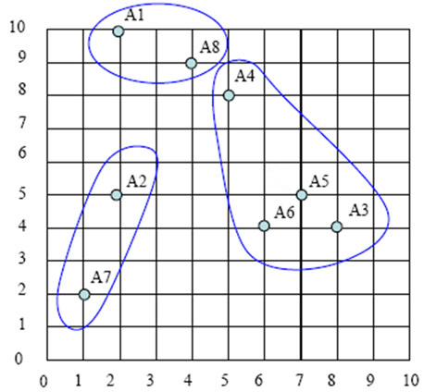
Understanding clustering
k-means example
Step 5: repeat Step 3 until the centroid don’t change
Step 3: Form k clusters by assigning all points to the closest centroid
C1
C2
C3

Slide 18
Understanding clustering
k-means example
Step 4: Recompute the centroid of each cluster (Calculate the mean of each cluster)
 | Point | Cluster | Mean of C#
A1 | (2, 10) | C1 | (3, 9.5)
A8 | (4, 9) | C1
A3 | (8, 4) | C2 | (6.5, 5.25)
A4 | (5, 8) | C2
A5 | (7, 5) | C2
A6 | (6, 4) | C2
A7 | (1, 2) | C3 | (1.5, 3.5)
A2 | (2, 5) | C3

Slide 19
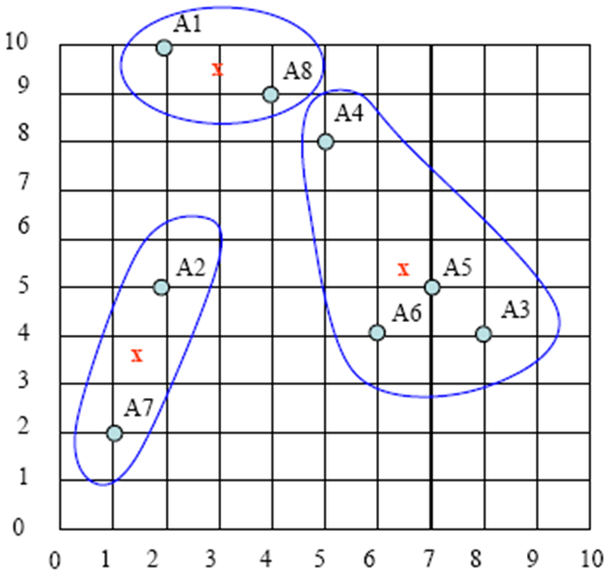
Understanding clustering
k-means example
Step 4: Recompute the centroid of each cluster (Calculate the mean of each cluster)
New centroids
C1
C2
C3

Slide 20
Understanding clustering
k-means example
Step 5: repeat Step 3 until the centroid don’t change
Step 3: Form k clusters by assigning all points to the closest centroid
 | Point | C1(3, 9.5) | C2(6.5, 5.25) | C3(1.5, 3.5) | Cluster
A1 | (2, 10) | 1.11 | 6.54 | 6.51 | C1
A2 | (2, 5) | 4.60 | 4.5 | 1.58 | C3
A3 | (8, 4) | 7.43 | 1.95 | 6.51 | C2
A4 | (5, 8) | 2.5 | 3.13 | 5.70 | C1
A5 | (7, 5) | 6.02 | 0.55 | 5.70 | C2
A6 | (6, 4) | 6.26 | 1.34 | 4.52 | C2
A7 | (1, 2) | 7.76 | 6.38 | 1.58 | C3
A8 | (4, 9) | 1.11 | 4.5 | 6.04 | C1

Slide 21
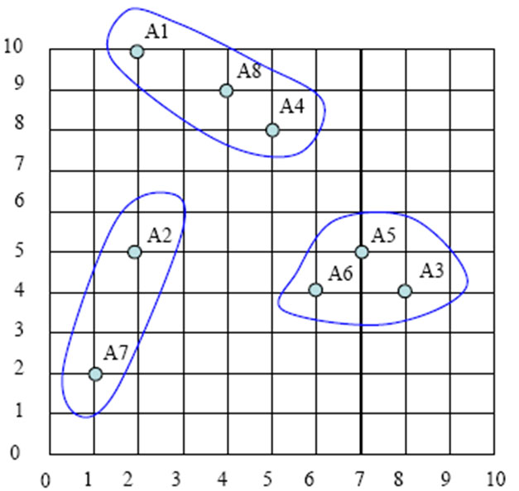
Understanding clustering
k-means example
Step 5: repeat Step 3 until the centroid don’t change
Step 3: Form k clusters by assigning all points to the closest centroid
C1
C2
C3

Slide 22
Understanding clustering
k-means example
Step 4: Recompute the centroid of each cluster (Calculate the mean of each cluster)
 | Point | Cluster | Mean of C#
A1 | (2, 10) | C1 | (3.66, 9)
A8 | (4, 9) | C1
A4 | (5, 8) | C1
A3 | (8, 4) | C2 | (7, 4.33)
A5 | (7, 5) | C2
A6 | (6, 4) | C2
A7 | (1, 2) | C3 | (1.5, 3.5)
A2 | (2, 5) | C3

Slide 23
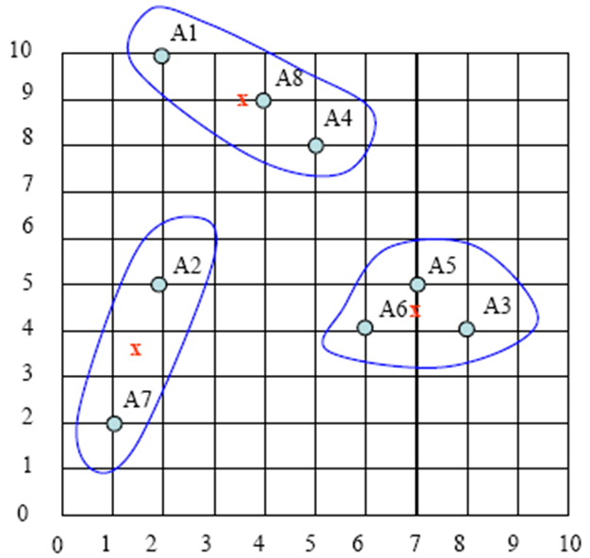
Understanding clustering
k-means example
Final cluster result
C1
C1
C2
C2
C3
C3

Slide 24
Clustering Techniques
K-Means in Python
from sklearn.cluster import KMeans
import numpy as np
X = np.array([[2, 10], [2, 5], [8, 4],[5, 8], [7, 5], [6, 4], [1, 2], [4, 9]])
kmeans = KMeans(n_clusters=3).fit(X)
print("Labels: ", kmeans.labels_)
print("Cluster Centers: ", kmeans.cluster_centers_)
print("Predict Values: ", kmeans.predict([[1, 1]]))
Labels: [2 1 0 2 0 0 1 2]
Cluster Centers: [[7. 4.33333333]
[1.5 3.5 ]
[3.66666667 9. ]]
Predict Values: [1]

Slide 25
Clustering Techniques
K-Means visualization in Python
from sklearn.cluster import KMeans
import numpy as np
import matplotlib.pyplot as plt
X = np.array([[2, 10], [2, 5], [8, 4],[5, 8], [7, 5], [6, 4], [1, 2], [4, 9]])
kmeans = KMeans(n_clusters=3).fit(X)
plt.scatter(X[:,0], X[:,1], c=kmeans.labels_, cmap='rainbow')
plt.scatter(kmeans.cluster_centers_[:,0] ,kmeans.cluster_centers_[:,1], color='black', marker="+", s=200)
plt.show()

Slide 26
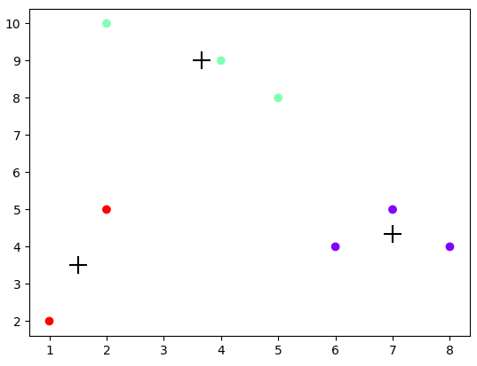
Clustering Techniques
K-Means visualization in Python

Slide 27
Clustering Techniques
K-Means visualization in Python
r15 dataset (r15.csv) -> n_clusters=15
from sklearn.cluster import KMeans
import pandas as pd
import matplotlib.pyplot as plt
sample_df = pd.read_csv("D:/r15.csv")
training_points = sample_df[["col1", "col2"]]
training_labels = sample_df["target"]
kmeans = KMeans(n_clusters=15).fit(training_points)
plt.scatter(training_points["col1"], training_points["col2"], c=kmeans.labels_,
cmap='rainbow')
plt.show()

Slide 28
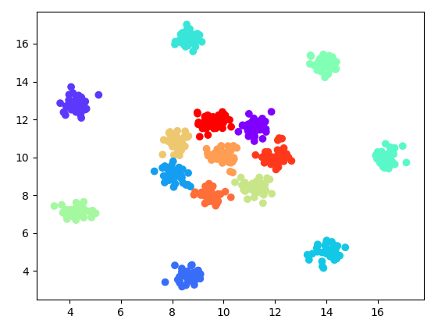
Clustering Techniques
K-Means visualization in Python
r15 dataset (r15.csv) -> n_clusters=15

Slide 29
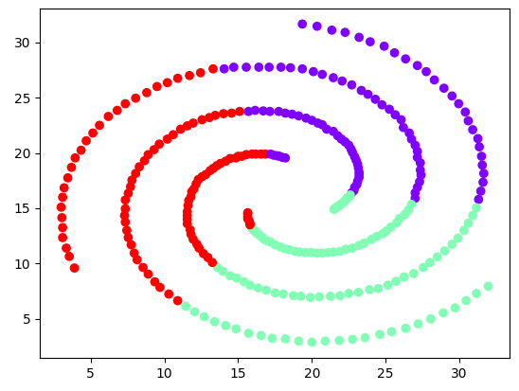
Clustering Techniques
K-Means visualization in Python
spiral dataset (spiral.csv) -> n_clusters=3

Slide 30
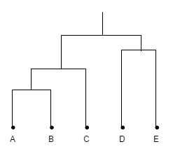
Clustering Techniques
Agglomerative clustering
Grouping data objects into a hierarchy or “tree” of clusters
Dendrogram is used to represent the process of hierarchical clustering

Slide 31
Clustering Techniques
Agglomerative clustering
Bottom-up strategy
Starts by letting each object form its own cluster
Iteratively merges clusters into larger and larger clusters
Until all the objects are in a single cluster
Agglomerative hierarchical clustering : Procedure
Each object forms one cluster
Merges the two closest (similar) clusters at the lowest level into one cluster
Repeat step 2 until it becomes a single cluster

Slide 32
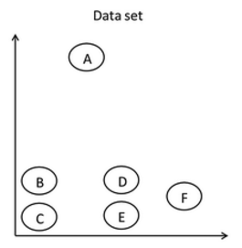
Clustering Techniques
Agglomerative clustering example

Slide 33
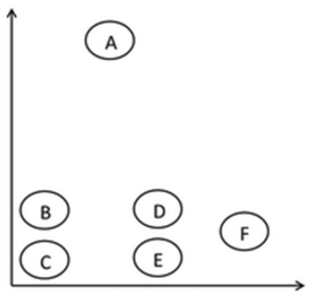

Clustering Techniques
Agglomerative clustering example
Data set
Agglomerative clustering of data (tree)

Slide 34
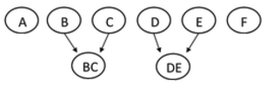
Clustering Techniques
Agglomerative clustering example
Data set
Agglomerative clustering of data (tree)

Slide 35
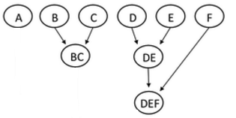
Clustering Techniques
Agglomerative clustering example
Data set
Agglomerative clustering of data (tree)

Slide 36
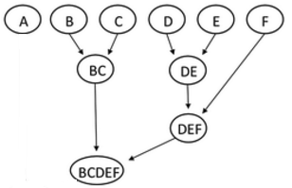
Clustering Techniques
Agglomerative clustering example
Data set
Agglomerative clustering of data (tree)

Slide 37
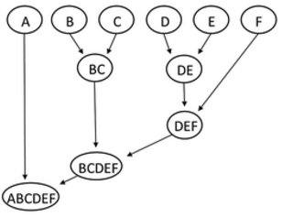
Clustering Techniques
Agglomerative clustering example
Data set
Agglomerative clustering of data (tree)

Slide 38
Clustering Techniques
Agglomerative clustering in Python
r15 dataset (r15.csv) -> n_clusters=15
from sklearn.cluster import AgglomerativeClustering
import pandas as pd
import matplotlib.pyplot as plt
sample_df = pd.read_csv("D:/r15.csv")
training_points = sample_df[["col1", "col2"]]
training_labels = sample_df["target"]
agglo = AgglomerativeClustering(n_clusters=15).fit(training_points)
plt.scatter(training_points["col1"], training_points["col2"], c=agglo.labels_,
cmap='rainbow')
plt.show()

Slide 39
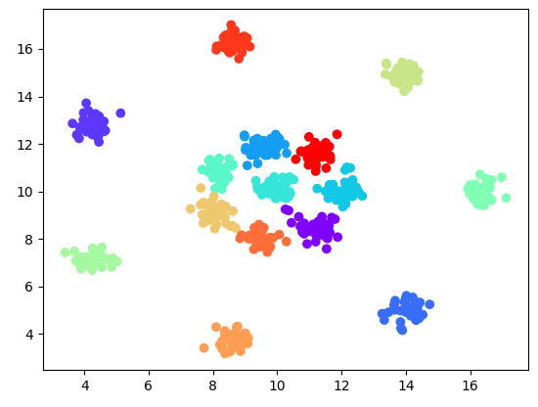
Clustering Techniques
Agglomerative clustering in Python
r15 dataset (r15.csv) -> n_clusters=15

Slide 40
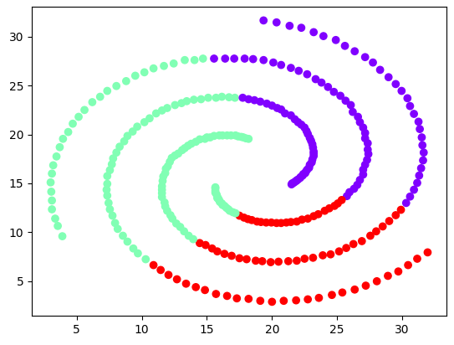
Clustering Techniques
Agglomerative clustering in Python
spiral dataset (spiral.csv) -> n_clusters=3

Slide 41
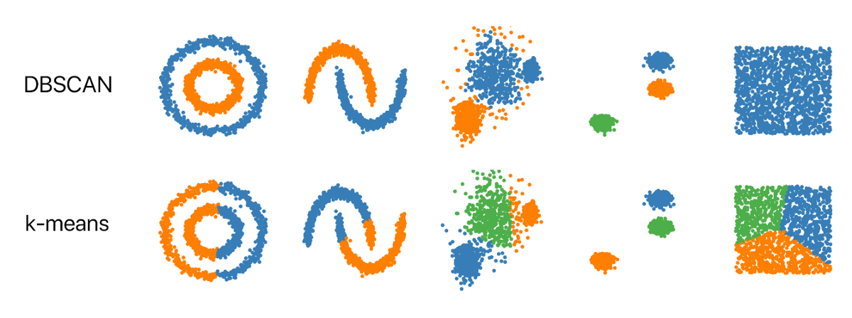
Clustering Techniques
What is DBSCAN?
Clustering based on density-connected points
Continues growing a given cluster as long as the density in the “neighborhood” exceeds some threshold

Slide 42
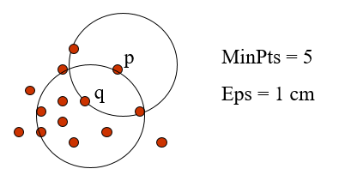
Clustering Techniques
DBSCAN parameters
Epsilon (𝜺)
Maximum radius of the neighborhood
minPts
Minimum number of points in an Eps-neighborhood of that point
Notes:
\

Slide 43
Clustering Techniques
DBSCAN parameters
A Core object is an object that meets the minimum number of points in the 𝜀-neighborhood
The object q is a core object

Slide 44
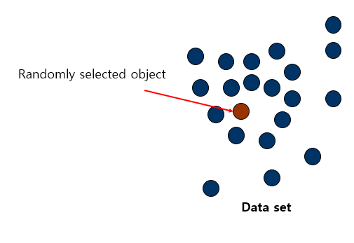
Clustering Techniques
DBSCAN example

Slide 45
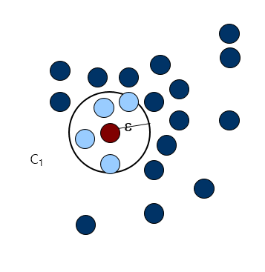
Clustering Techniques
DBSCAN example

Slide 46
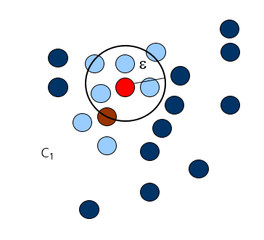
Clustering Techniques
DBSCAN example

Slide 47
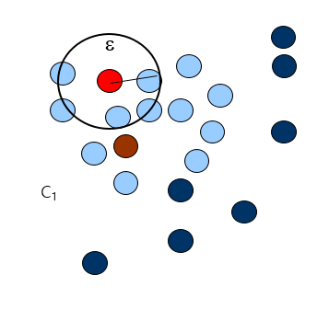
Clustering Techniques
DBSCAN example

Slide 48
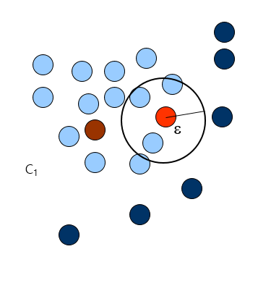
Clustering Techniques
DBSCAN example
Notes:
https://www.naftaliharris.com/blog/visualizing-dbscan-clustering/

Slide 49
Clustering Techniques
DBSCAN in Python
r15 dataset (r15.csv)
from sklearn.cluster import DBSCAN
import pandas as pd
import matplotlib.pyplot as plt
sample_df = pd.read_csv("D:/r15.csv")
training_points = sample_df[["col1", "col2"]]
training_labels = sample_df["target"]
dbscan = DBSCAN(eps=0.6, min_samples=10).fit(training_points)
plt.scatter(training_points["col1"], training_points["col2"], c=dbscan.labels_,
cmap='rainbow')
plt.show()

Slide 50
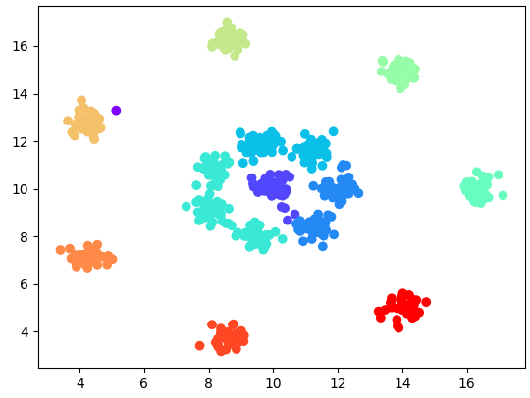
Clustering Techniques
DBSCAN in Python

Slide 51
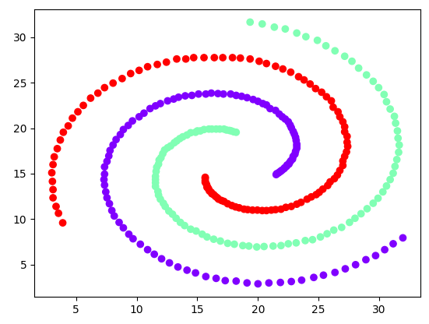
Clustering Techniques
DBSCAN in Python

Slide 52
Evaluation of Clustering
C

Slide 53
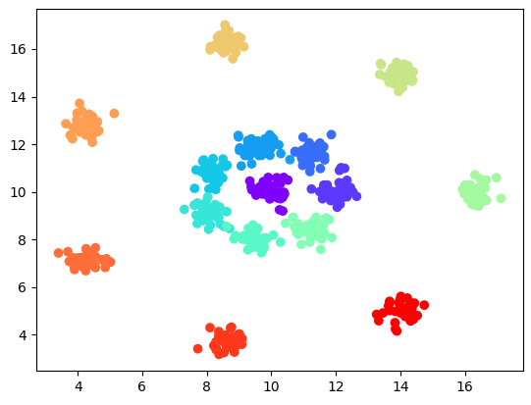
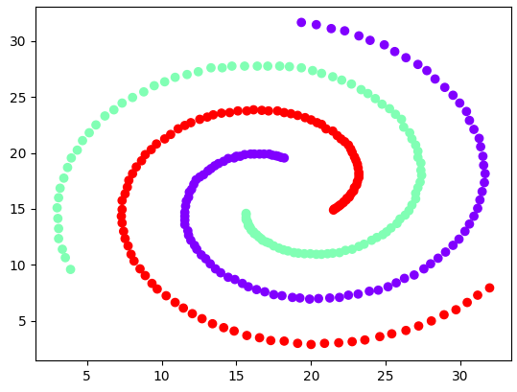
Evaluation of Clustering
Why evaluate?
Comparison on r15
Comparison on spiral
<Ground Truth>
<K-Means>
<Agglomerative>
<DBSCAN>
<Ground Truth>
<K-Means>
<Agglomerative>
<DBSCAN>

Slide 54
Evaluation of Clustering
Adjusted Rand Index
Computes a similarity measure between two clustering
Calculated used the following formula:
It has two parameters
labels_true
Ground truth class labels
labels_pred
Clusters label to evaluate

Slide 55
Clustering Techniques
Adjusted Rand Index for K-Means
r15 dataset (r15.csv)
from sklearn.cluster import KMeans
import pandas as pd
from sklearn.metrics.cluster import adjusted_rand_score
sample_df = pd.read_csv("D:/r15.csv")
training_points = sample_df[["col1", "col2"]]
training_labels = sample_df["target"]
kmeans = KMeans(n_clusters=15).fit(training_points)
arc = adjusted_rand_score(training_labels, kmeans.labels_)
print(arc)
0.9927781994136302

Slide 56
Use Case
D

Slide 57
Useful
Customer Segmentation
https://www.kaggle.com/karnikakapoor/customer-segmentation-clustering
SaaS Data Analysis
https://medium.com/@sygong/k-means-clustering-for-customer-segmentations-a-practical-real-world-example-196a10323b9f
Anime recommendation based on user clustering
https://www.kaggle.com/karnikakapoor/customer-segmentation-clustering
Segmenting and Clustering Airbnb Listings in Zurich, Switzerland
https://www.linkedin.com/pulse/segmenting-clustering-airbnb-listings-zurich-georgios-chatzis/

Slide 58
Final Task
Submit your source code for the following task:
Try all source code in the lecture
Submission: source code, result screenshots and result explanation
Deadline: May 25, 2022, 11:59

